Slide 1

Sending and receiving information among computers

Slide 2
Objectives
Describe the basic components of a network
Explain the methods of data transmission, including types of signals, modulation, and choices among transmission modes
Differentiate among the various kinds of communications links and appreciate the need for protocols
Describe various network configurations
List the components, types, and protocols of a local area network
Appreciate the complexity of networking
Describe some examples of networking

Slide 3
The technical and business community recognized the need to share information among com- puters. However, there were still a few hurdles that needed to be overcome before a computer network could be created.
The earliest PC network linked computers and a printer through an electronic switch. This posed less of a challenge than networking computers together since information flowed in one direction: from a computer to the electronic switch.

Slide 4
Tech Talk Protocol:
A set of rules that determines the method that will be used to do a task, such as to send and receive information.
expected response.

Slide 5
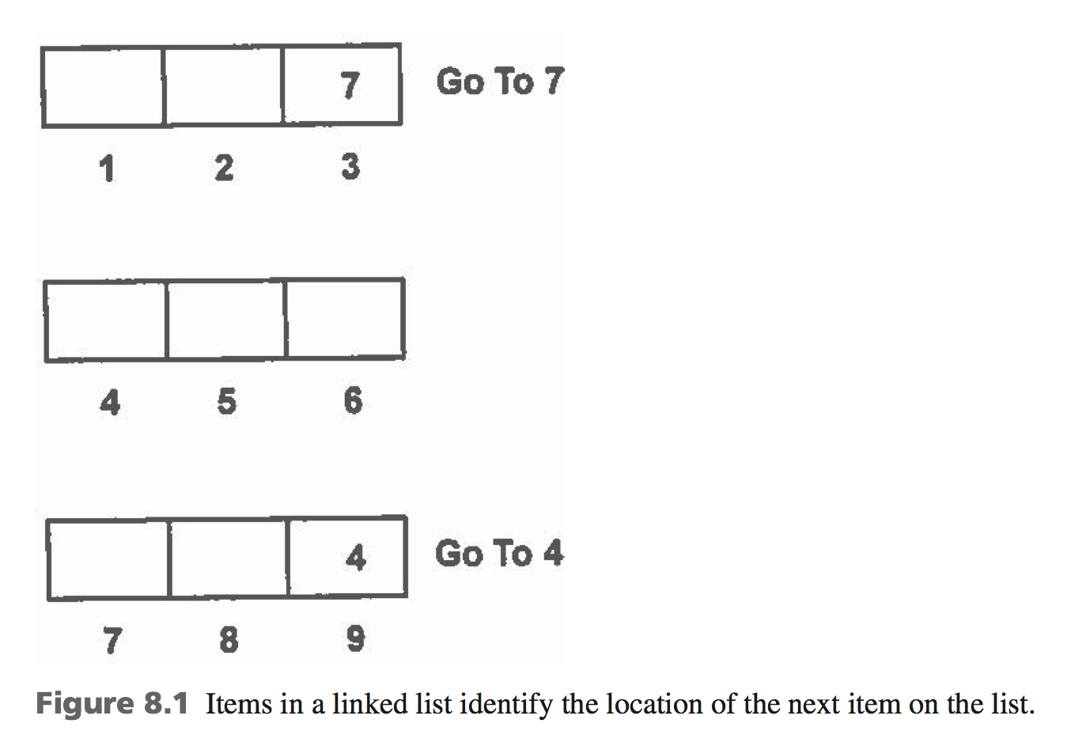

Slide 6
Asynchronous communication:
Divides information into pieces and transmits each piece separately to the remote computer. The remote computer acknowledges each piece before the next piece is sent. The pieces are reassembled at the destination.

Slide 7
Tech Talk File server:
A dedicated computer on a computer network that is used to store flies that are shared among computers connected to the network.

Slide 8
Tech Talk Contention:
When two or more computers attempt to access a network resource at the same time.
New technology had to be developed to meet these challenges. Technicians focused on three components: a network circuit board, cabling, and a network operating system

Slide 9
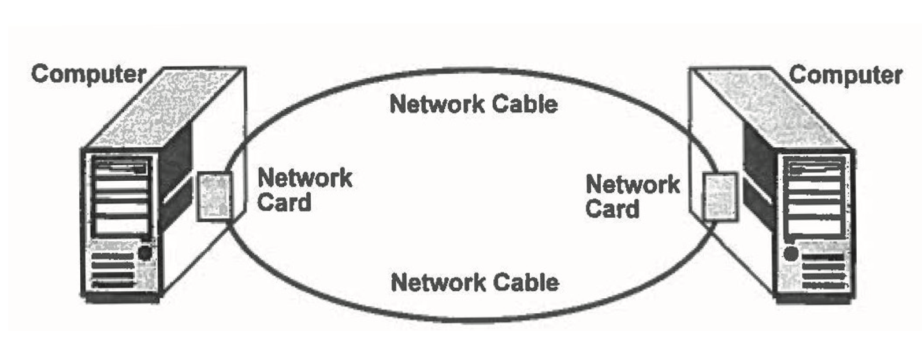
A network circuit board called a network card provided the extension of the bus inside the computer to the network. Think of the network card like the on and off ramp from the local streets to the highway.
Cabling is the electronic highway connecting computers with the file server and the early PC networks used the same type of cable that connects your telephone to the telephone net- work. This is called twisted pair.

Slide 10
Contents
Data Communications
Network
Data Transmission
Communications Media
Network Topology
Local Area Network
Wide Area Network
Organization of Resources
Protocol
Software
Communication Applications

Slide 11
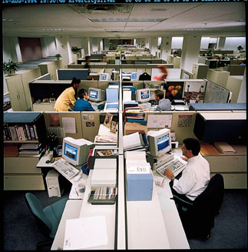
Data Communications
Send and receive information over communications lines

Slide 12
Centralized Data Processing
All processing, hardware, software in one central location
Inefficient
Inconvenient

Slide 13
Distributed Data Processing
Computers at a distance from central computer
Can do some processing on their own
Can access the central computer

Slide 14
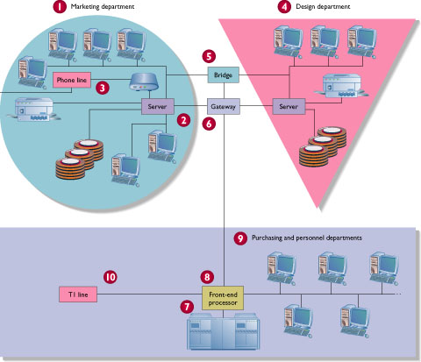
Distributed Data Processing

Slide 15
Network
Uses communication equipment to connect two or more computers and their resources
PC based
LAN – shares data and resources among users in close proximity
WAN – shares data among users who are geographically distant

Slide 16
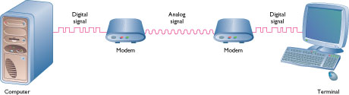
Basic Components
Sending device
Communications link
Receiving device

Slide 17
Network Design
Transmission
Media
Topology – Physical layout of components
Protocol – Rules governing communication
Distance
LAN
WAN
Technology
Peer-to-peer
File server
Client/server

Slide 18
Data Transmission
Digital lines
Sends data as distinct pulses
Need digital line
Analog lines
Sends a continuous electrical signal in the form of a wave
Conversion from digital to analog needed
Telephone lines, coaxial cables, microwave circuits

Slide 19
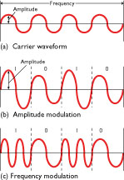
Analog Transmission
Alter the carrier wave
Amplitude – height of the wave is increased to represent 1
Frequency – number of times wave repeats during a specific time interval can be increased to represent a 1

Slide 20
Modem
Modulate
Convert from digital to analog
Demodulate
Convert from analog to digital
Speeds up to 56,000 bps (56K)

Slide 21
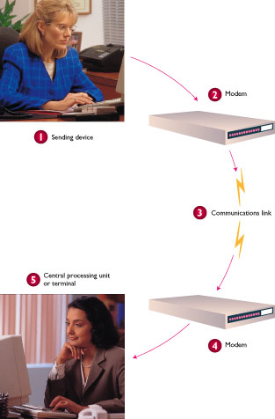
Modem
Transmission process
Modulation – Computer digital signals converted to analog
Sent over analog phone line
Demodulation – Analog signal converted back to digital

Slide 22
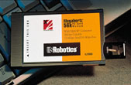
Types of Modems
Direct-connect
External
Internal
PCMCIA
Personal Computer Memory Card International Association
Notebook and laptop computers

Slide 23
DSL Digital Subscriber Line
Uses conventional telephone lines
Uses multiple frequencies to simulate many modems transmitting at once
No industry standard
Cost
Speed
Phone line shared between computer and voice

Slide 24
Cable Modem
Coaxial cables
Does not interfere with cable TV reception
Up to 10 million bps
Always on
Shared capacity
Security problem

Slide 25
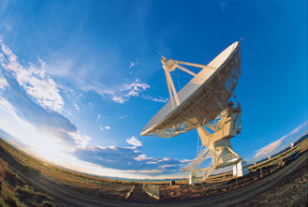
Cellular Modems
Uses cellular telephone system
Slow speed

Slide 26
ISDN Integrated Services Digital Network
Digital transmission
Speeds of 128,000 bps
Connect and talk at same time
Need
Adapter
Upgraded phone service
Initial costs high
Ongoing monthly fees may be high
Not available in all areas

Slide 27
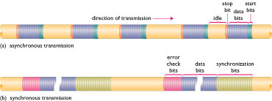
Transmission Asynchronous and Synchronous
Sending and receiving devices must work together to communicate

Slide 28
Asynchronous Transmission
Start/stop transmission
Start signal
Group – generally one character
Stop signal
Low-speed communications

Slide 29
Synchronous Transmission
Blocks of data transmitted at a time
Send bit pattern
Align internal clock of sending / receiving devices
Send data
Send error-check bits
More complex
More expensive
Faster transmission

Slide 30
Duplex Setting
Direction of data flow
Simplex
One direction
Television broadcasting
Arrival/departure screens at airport
Half-duplex
Either direction, but one way at a time
CB radio
Bank deposit sent, confirmation received
Full-duplex
Both directions at once
Telephone conversation

Slide 31
Communications Media
Physical means of transmission
Bandwidth
Range of frequencies that the medium can carry
Measure of capacity

Slide 32
Network Cable
Twisted pair
Coaxial cable
Fiber optic cable
Wireless
Uses infrared or low-power radio wave transmissions
No cables
Easy to set up and reconfigure
Slower transmission rates
Small distance between nodes

Slide 33
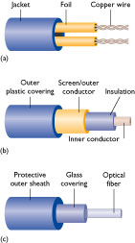
Twisted Pair Wire Pair
Inexpensive
Susceptible to electrical interference (noise)
Telephone systems
Physical characteristics
Requires two conductors
Twisted around each other to reduce electrical interference
Plastic sheath
Shielded twisted pair
Metallic protective sheath
Reduces noise
Increases speed

Slide 34
Coaxial Cable
Higher bandwidth
Less susceptible to noise
Used in cable TC systems
Physical characteristics
Center conductor wire
Surrounded by a layer of insulation
Surrounded by a braided outer conductor
Encased in a protective sheath

Slide 35
Fiber Optics
Transmits using light
Higher bandwidth
Less expensive
Immune to electrical noise
More secure – easy to notice an attempt to intercept signal
Physical characterizes
Glass or plastic fibers
Very thin (thinner than human hair)
Material is light

Slide 36
Microwave Transmission
Line-of-site
High speed
Cost effective
Easy to implement
Weather can cause interference
Physical characteristics
Data signals sent through atmosphere
Signals cannot bend of follow curvature of earth
Relay stations required

Slide 37
Satellite Transmission
Microwave transmission with a satellite acting as a relay
Long distance
Components
Earth stations – send and receive signals
Transponder – satellite
Receives signal from earth station (uplink)
Amplifies signal
Changes the frequency
Retransmits the data to a receiving earth station (downlink)

Slide 38
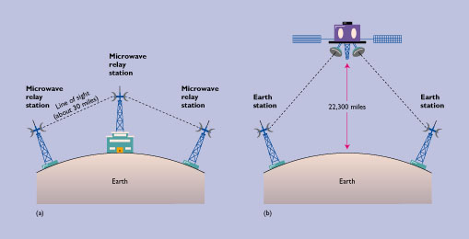
Satellite Transmission

Slide 39
Combination
Example – East and West coast:
Request made
Twisted pair in the phone lines on the East Coast
Microwave and satellite transmission across the country
Twisted pair in the phone lines on the West coast
Data transferred
Twisted pair in the phone lines on the West Coast
Microwave and satellite transmission across the country
Twisted pair in the phone lines on the East coast

Slide 40
LAN Local Area Network
Components
PCs
Network cable
NIC
Connections over short distances through communications media

Slide 41
NIC Network Interface Card
Connects computer to the wiring in the network
Circuitry to handle
Sending
Receiving
Error checking

Slide 42
Connecting LANs
Bridge – connects networks with similar protocols
Router – directs traffic via best path
IP switches
Replacing routers
Less expensive
Faster
Gateway
Connects LANs with dissimilar protocols
Performs protocol conversion

Slide 43
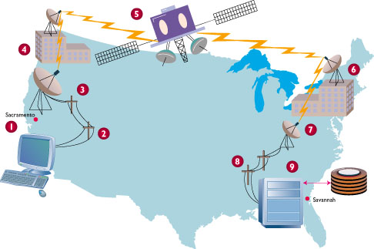
WAN Wide Area Network
Link computers in geographically distant locations

Slide 44
Communication Services
Common carriers licensed by FCC (Federal Communications Commission)
Switched / dial-up service
Temporary connection between 2 points
Ex: plain old telephone service (POTS)
Dedicated service
Permanent connection between 2 or more locations
Ex: Build own circuits, Lease circuits (leased lines)

Slide 45
High Capacity Digital Lines
T1
1.54 Mbps
24 simultaneous voice connections
T3
28 T1 lines
43 Mbps
Expensive
High-volume traffic

Slide 46
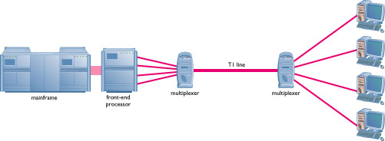
Multiplexer
Combines data streams from slow-speed devices into single data stream
Transmits over high-speed circuit (ex T1)
Multiplexer on receiving end needed to restore to component data streams

Slide 47
Organization of Resources Client/Server and File Server
Server
Controls the network
Hard disk holding shared files
Clients
Other computers on network
Thin client – no processing

Slide 48
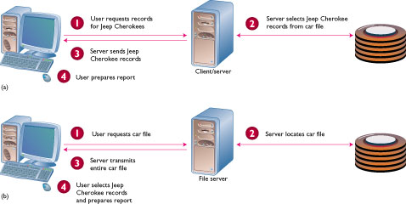
Organization of Resources Client/Server and File Server

Slide 49
Organization of Resources File Server
Server transmits file to client
Client does own processing

Slide 50
Organization of Resources Client/Server
How it works
Client sends request for service to server
Server fulfills request and send results to client
Client and server may share processing
Benefits
Reduces volume of data traffic
Allows faster response for each client
Nodes can be less expensive computers

Slide 51
Organization of Resources Peer-to-Peer
All computers have equal status
Share data and devices as needed
Common with up to 12 computers
Disadvantage – slow transmission

Slide 52
Organization of Resources Hybrid
Contains elements of various organizations to optimize transmission speed and organizational needs

Slide 53
File Transfer Software
Download
Receive a file from another computer
Upload
Send a file to another computer

Slide 54
Terminal Emulation Software
PC imitates a terminal for communication to mainframe
Micro-to-mainframe link

Slide 55
Office Automation Communication Applications
E-mail
Facsimile (Fax)
Groupware
Teleconferencing
Video conferencing
ATM
Electronic fund transfers
Telecommuting
Online services
The Internet
Electronic data interchange (EDI)

Slide 56
summary

